Slide 1
3D on the Web : Understanding the basics
Introduction to WebGL 3D with HTML5 and Babylon.js

Slide 2


WHO ARE WE?
Geeks, web developers, 3D addicts
DAVID ROUSSET
DAVID CATUHE
TECHNICAL EVANGELIST
PRINCIPAL PROGRAM MANAGER
Twitter: @davrous
http://blogs.msdn.com/davrous
Twitter: @deltakosh
http://blogs.msdn.com/eternalcoding
Do not try to tune your speakers, the weird sound is due to French accent…

Slide 3
TEASER
DEMO
Notes:
Assassins Creed Pirates
Hill Valley double virtual joystick on Windows Phone
Physics Espilit

Slide 4
AGENDA
1
Understanding 3D Basics via a soft engine
2
Moving from CPU to GPU

Slide 5
Section One
Understanding 3D Basics via a soft engine

Slide 6
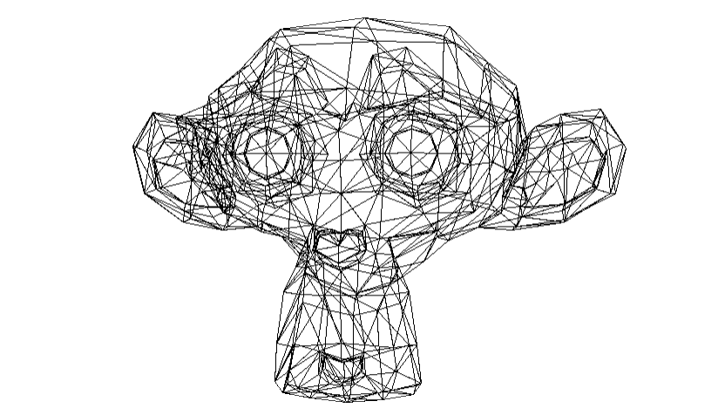
Wireframing

Slide 7
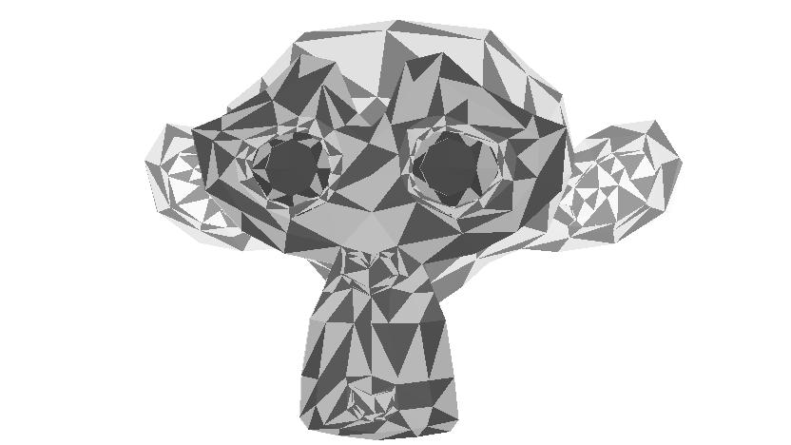
Rasterization

Slide 8
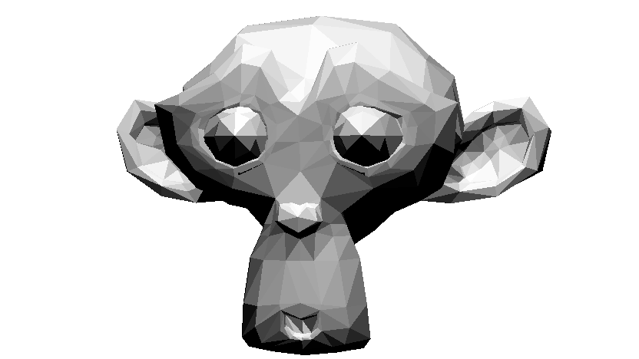
Flat Shading

Slide 9

Gouraud Shading

Slide 10
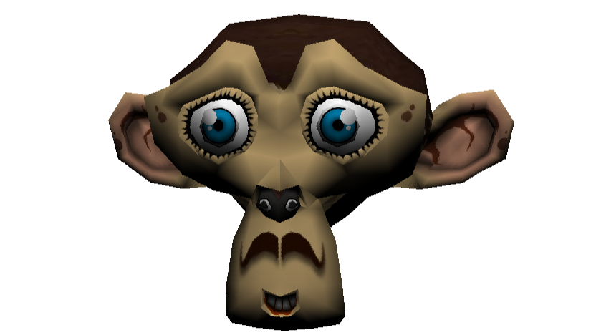
Texture mapping

Slide 11
SOFT ENGINE
DEMO
Notes:
http://david.blob.core.windows.net/html5/SoftEngineProgression/wireframe/index.html

Slide 12
Step One
Understanding the transformation pipeline

Slide 13
Some 3D engine vocabulary
A point in the 3D world = a vertex
Multiple vertex = vertices
Vector3 (x,y,z) is used for a 3D position or a direction
Triangle = face
A 3D object = a mesh

Slide 14
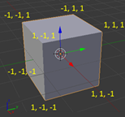
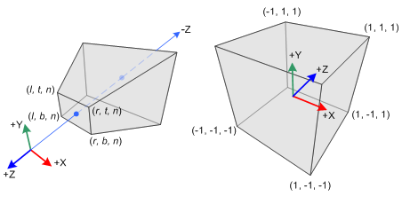
Spaces
Euclidean space using Cartesian coordinates : X, Y and Z
Local/Model Space
World Space
View/Camera Space (Point-of-view)
Screen space (2D)
Notes:
We are using some different spaces depending on where we looking from.
Object space: Local to an object, an object being a set of polygons. If you want to have multiple instances of the same object, at different locations in the world, you need object space.
World space: This coordinate system is the most important one. This is where all objects are positioned, where you do compute physics, movements and collisions detection. It is also here that lighting is computed. Think of the world space as your game world.
View space: This coordinate system is relative to the camera. Objects in world space are transformed to view space to know what is visible on the screen. This space is also commonly called "eye space" or "camera space".
Screen space (2D): Coordinates representation of the screen. Coordinates are not pixels though. The viewport maps view space to screen space, and the origin in screen space is in the middle of the screen (for perspective projections anyway).
Extracted from: Einar Öberg work: http://www.inear.se/2011/04/a-brief-introduction-to-3d/

Slide 15
LET’S START SIMPLE: 8 VERTICES
DEMO
Notes:
Comment the complete code in SublimeText

Slide 16
Step Two
It’s all about triangles

Slide 17
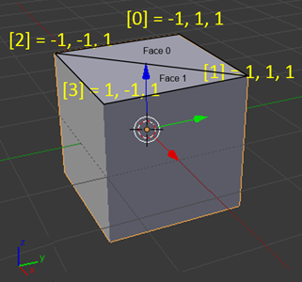
Drawing triangles for a cube
A cube is made of 8 vertices
Each face is made of 3 vertices
A cube is made of 12 faces
Notes:
/

Slide 18
DRAWING TRIANGLES
DEMO
Notes:
Show the square code and run it
Opening SoftEngine.js in SublimeText
Modify the code to build the complete cube

Slide 19
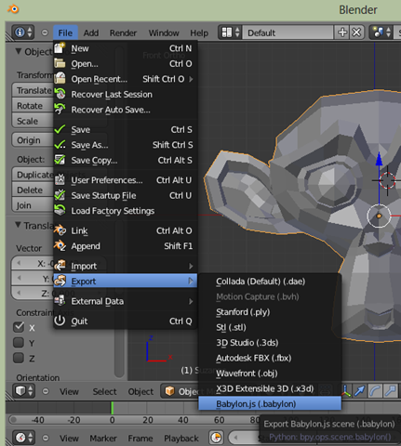
Generating geometries from a 3D modeler
Once you know how to load a cube, you know how to load everything
But you don’t want to hard code every vertex/face yourself right?
So, let’s export them from Blender!

Slide 20
LOADING A JSON FORMAT FROM BLENDER
DEMO
Notes:
Open Blender
Show how to install the plug-in (link from the blog)
Remove the cube and add a torus instead
Open the generated .babylon file to explain it’s a JSON format
Create a VS Web solution, drag’n’drop the part 3 files
Show the JSON loader part
Modify the web.config file to add a mime type and explain why
Return to blender and export Suzanne

Slide 21
Step Three
Filling the triangles with the proper pixels

Slide 22
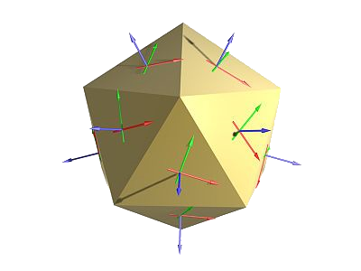
Rasterization
Algorithm to fill the triangle with lines
Pay attention to Z-order via a depth buffer
To add lights & shadows we need normals
There are different kinds of shading algorithms like:
Flat Shading: 1 normal per face, on its center
Gouraud Shading: 3 normals per face on each vertex, using interpolation to compute the color via gradients

Slide 23
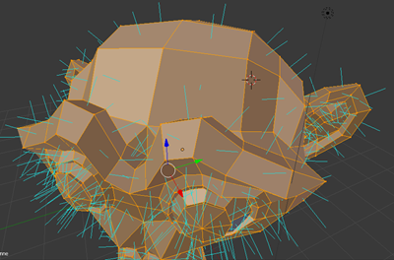
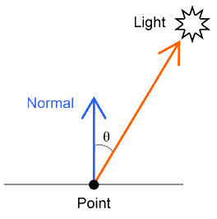
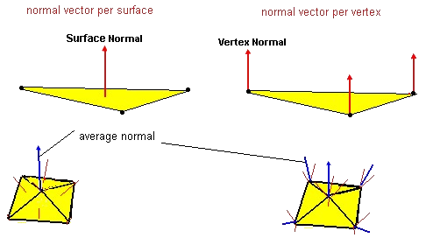
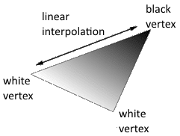
Flat & Gouraud Shading explained

Slide 24
RASTERIZATION, FLAT & GOURAUD SHADING
DEMO
Notes:
Demo rasterization without z-buffering
Demo with z-buffering
Demo Flat Shading
Demo Gouraud Shading

Slide 25
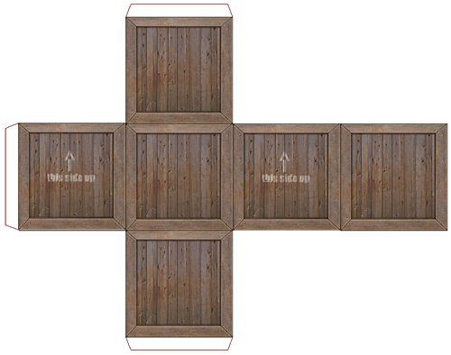
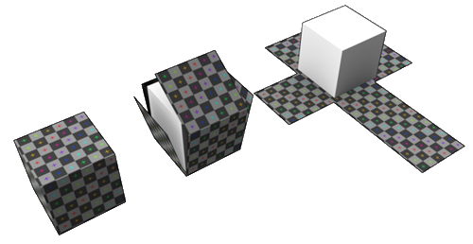
Texture mapping – basic concepts

Slide 26
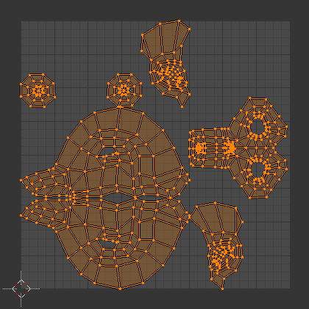
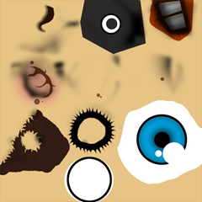
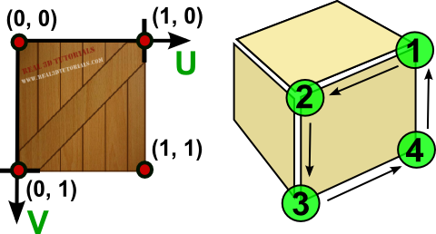
Texture mapping – unwrapping & UV mapping

Slide 27
TEXTURE MAPPING
DEMO

Slide 28
Section Two
Moving from CPU to GPU

Slide 29
The rise of GPUs
Hardware accelerated rendering:
2D Canvas, CSS3 animations
Accelerated 3D
with WebGL
H264 & JPG hardware decoding

Slide 30
Going further
Tutorial series: learning how to write a 3D soft engine from scratch in C#, TypeScript or JavaScript
The detailed version of the 3D Software Engine we’ve studied together in this course
Unleash the power of HTML 5 Canvas for gaming
Where you’ll some interesting points around canvas 2D optimization tricks

